Slide 2
Micro-Services Design Patterns

Slide 3
Design Patterns in Micro Services
Aggregator.
API Gateway.
Chained or Chain of Responsibility.
Asynchronous Messaging.
Database or Shared Data.
Event Sourcing.
Branch.
Command Query Responsibility Segregator.

Slide 4
Aggretator
In Microservices patterns, Aggregator is a basic web page which invokes various services to get the required information or achieve the required functionality.
This pattern proves to be beneficial when an output is needed by combining data from multiple services.
E.g. if there are two services each having their own database, then an aggregator having a unique transaction ID, would collect the data from each individual microservice, apply the business logic and finally publish it as a REST endpoint. Later on, the data collected can be consumed by the respective services which require that collected data.
The Aggregate Design Pattern is based on the DRY principle. Based on this principle, you can abstract the logic into a composite microservices and aggregate that particular business logic into one service.

Slide 5
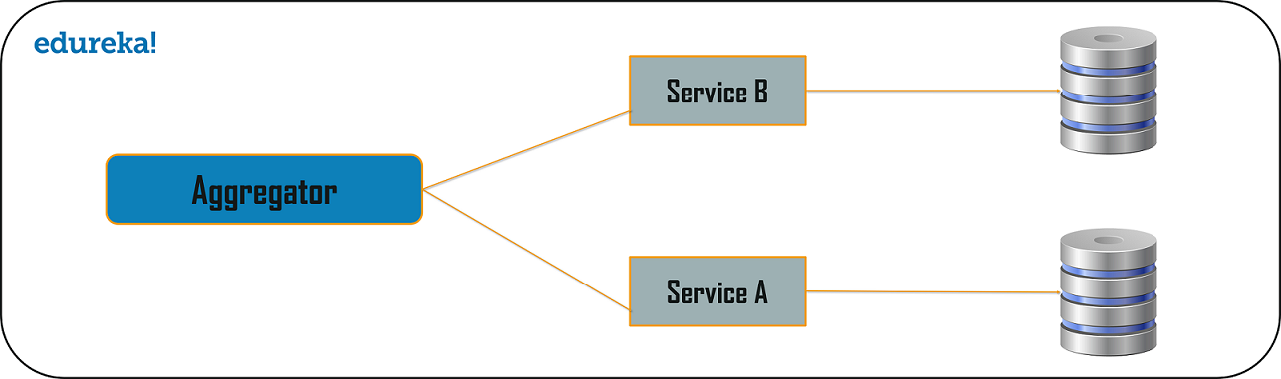
contd..

Slide 6
API Gateway
The problems with MS design could be as follows:
How can info be requested from multiple microservices?
Different UI require different data to respond to the same backend database service
How to transform data according to the consumer requirement from reusable Microservices
How to handle multiple protocol requests?
The API Gateway Design Pattern address the concerns above but and solves many other problems.
This microservice design pattern can also be considered as the proxy service to route a request to the concerned microservice.
Being a variation of the Aggregator service, it can send the request to multiple services and similarly aggregate the results back to the composite or the consumer service. API

Slide 7
contd..
Gateway also acts as the entry point for all the microservices and creates fine-grained APIs’ for different types of clients.
The API gateways can convert the protocol request from one type to other. Similarly, it can also offload the authentication/authorization responsibility of the microservice.
Once the client sends a request, these requests are passed to the API Gateway which acts as an entry point to forward the clients’ requests to the appropriate microservices.
Then, with the help of the load balancer, the load of the request is handled and the request is sent to the respective services.
Microservices use Service Discovery which acts as a guide to find the route of communication between each of them. Microservices then communicate with each other via a stateless server i.e. either by HTTP Request/Message Bus.

Slide 8
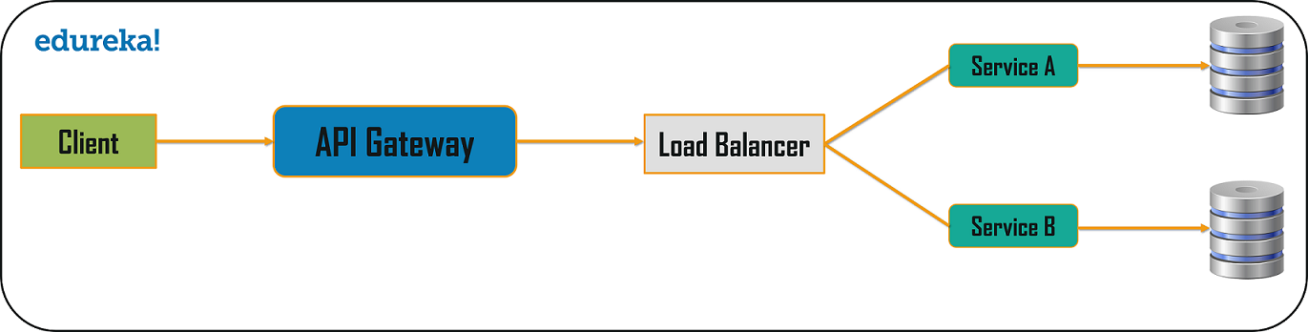
contd..

Slide 9
Chained or Chain of Responsibility
This design pattern produces a single output which is a combination of multiple chained outputs.
If there are three services lined up in a chain, then, the request from the client is first received by Service A. Then, this service communicates with the next Service B and collects data. Finally, the second service communicates with the third service to generate the consolidated output.
All these services use synchronous HTTP request or response for messaging. Also, until the request passes through all the services and the respective responses are generated, the client doesn’t get any output. So, it is always recommended to not to make a long chain, as the client will wait until the chain is completed
One more important aspect which you need to understand, is that the request from Service A to Service B may look different from Service B to Service C. Similarly the response from Service C to Service B may look completely different from Service B to Service A

Slide 10
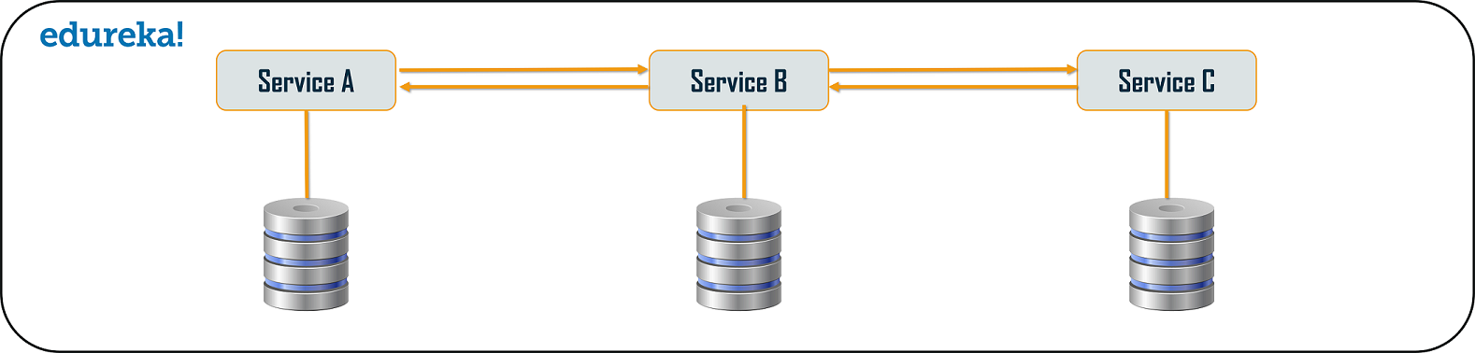
contd..

Slide 11
Asynchronous Messaging Design Pattern
In above patterns, the client gets blocked or has to wait for a long time in synchronous messaging.
Asynchronous Messaging brings down the wait for a long time.
In this type of microservices design pattern, all the services can communicate with each other, but they do not have to communicate with each other sequentially.
E.g. consider 3 services: Service A, Service B, and Service C.
The request from the client can be directly sent to the Service C and Service B simultaneously. These requests will be in a queue. Apart from this, the request can also be sent to Service A whose response need not have to be sent to the same service through which request has come.

Slide 12
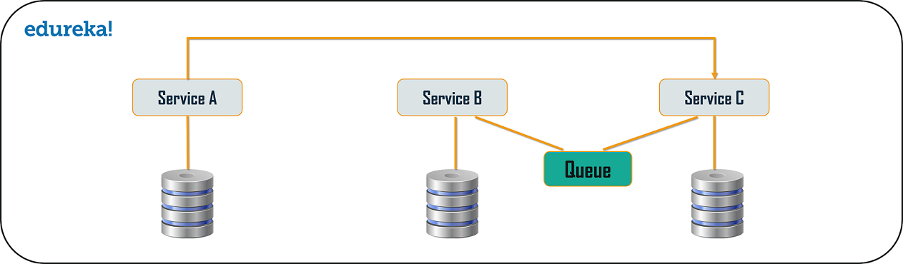
contd..

Slide 13
Database or Shared Data Pattern
The system can have a database per each service or it can have shared database per service. The database per service and shared database per service can solve various problems. The problems could be as follows:
Duplication of data and inconsistency
Different services have different kinds of storage requirements
Few business transactions can query the data, with multiple services
De-normalization of data

Slide 14
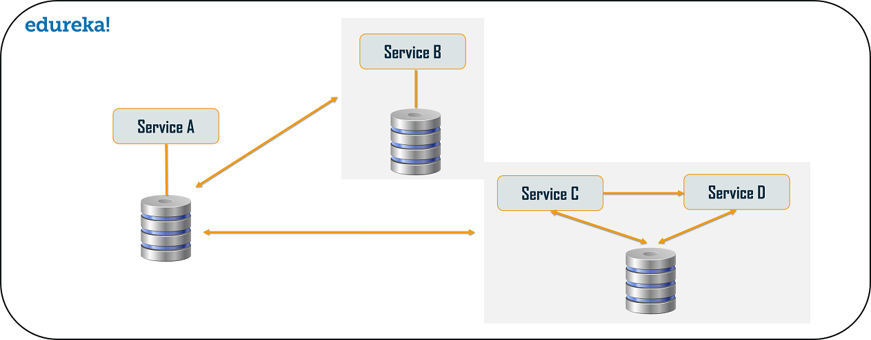
contd..

Slide 15
Event Sourcing Design Pattern
The event sourcing design pattern creates events regarding the changes in the application state.
These events are stored as a sequence of events to help the developers track which change was made when.
Used to always adjust the application state to cope up with the past changes.
User can query these events, for any data change and simultaneously publish these events from the event store. Once the events are published, the changes of the application state on the presentation layer can be seen.

Slide 16
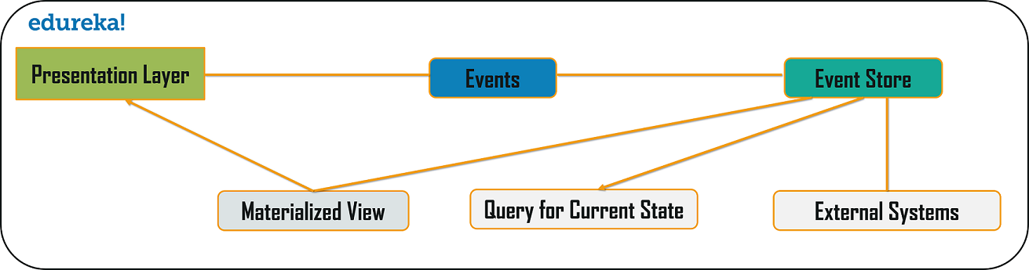
contd..

Slide 17
Branch Pattern
Branch microservice design pattern in which user can simultaneously process the requests and responses from two or more independent microservices.
Unlike the chained design pattern, the request is not passed in a sequence, but the request is passed to two or more mutually exclusive microservices chains.
This design pattern extends the Aggregator design pattern and provides the flexibility to produce responses from multiple chains or single chain.
E.g. consider an e-commerce application, and needed to retrieve data from multiple sources. The output could be a collaborated output of data from various services. Branch pattern is used to retrieve data from multiple sources.

Slide 18
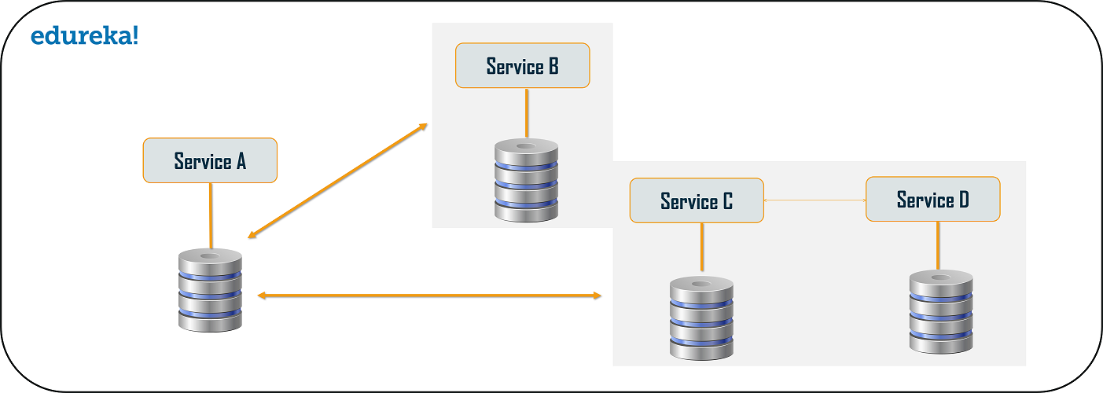
contd..

Slide 19
Command Query Responsibility Segregator (CQRS) Design Pattern
According to this pattern, the application will be divided into two parts: Command and Query.
The command part will handle all the requests related to CREATE, UPDATE, DELETE while the query part will take care of the materialized views.
The materialized views are updated through a sequence of events which are creating using the event source pattern discussed above.

Slide 20
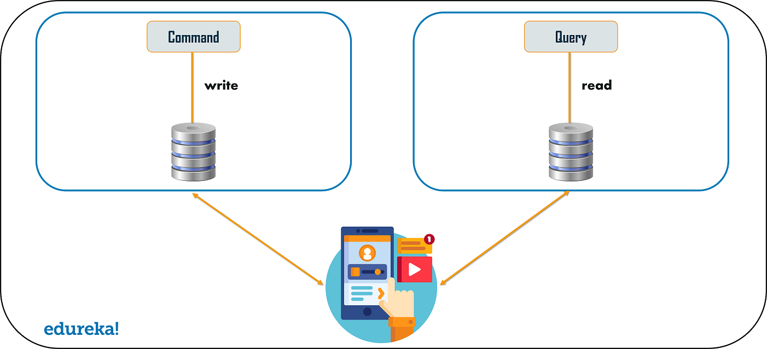
contd..

Slide 21
Circuit Breaker Pattern
The Circuit Breaker design pattern is used to stop the process of request and response if a service is not working.
E.g. let’s say a client is sending a request to retrieve data from multiple services. But, due to some issues, one of the services is down. Now, there are two problems – first, since the client will not have any knowledge about a particular service being down, the request will be continuously sent to that service. The second problem is that the network resources will be exhausted with low performance and bad user experience.

Slide 22
contd..
With the help of this pattern, the client will invoke a remote service via a proxy. This proxy will basically behave as a circuit barrier.
So, when the number of failures crosses the threshold number, the circuit breaker trips for a particular time period.
Then, all the attempts to invoke the remote service will fail in this timeout period. Once that time period is finished, the circuit breaker will allow a limited number of tests to pass through and if those requests succeed, the circuit breaker resumes back to the normal operation. Else, if there is a failure, then the time out period begins again.

Slide 23
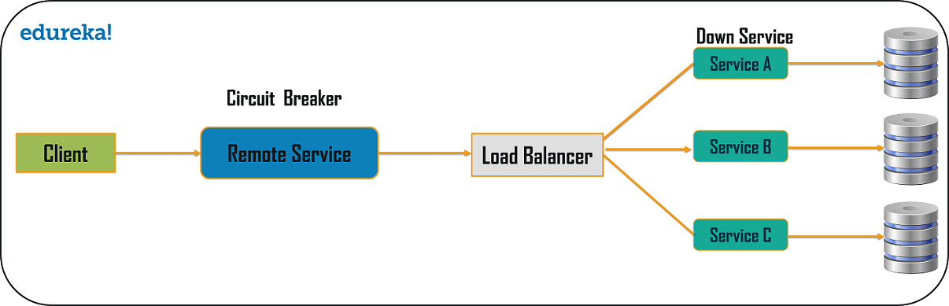
contd..

Slide 24
Migrating to Microservices
Step 1: Identify the Logical Component
There are three major components with the data used in the system:
Data objects
Data actions
Job to perform and use cases
The logical construct of the data that is being used in the system is data objects. The data actions are the commands used on one or more data objects, possibly on different types of data, to perform a task. Whereas the job to perform is the function called to perform a task on the available data.

Slide 25
contd..
Step 2: Flatten or Refractor Components
Once all the modules and components are uniquely identified and categorized, the businesses must organize these groups internally.
The components that have similar functionalities must be addressed before the implementation of microservice architecture.
In the end, there must be one microservice to perform a particular task.
Step 3: Identify the Dependencies of the Components
Upon identifying and reorganizing the components for migrating from a monolithic application to microservices, the system architects must identify the dependencies between the components.
Architects can perform this task using static analysis of the source code to search for calls between different libraries and datatypes.

Slide 26
contd..
Step 4: Components Group Identification
After the components and dependencies are identified, the architects must focus on grouping the components into cohesive groups that can transform into microservices.
This step aims to identify a small set of objects and their constituent actions that should be logically separated in the final system.
Step 5: APIs for Remote User Interface
The remote user interface is the only mode of communication among the system, its components, and the system’s users. The remote user interface must be scalable to adopt new features and technologies as the system evolves over the period.
The interface must be usable during migration and also once the microservice is deployed. Since the components are likely to change as they are worked upon, the remote user interface must manipulate the data when it is migrated from monolithic to microservices.

Slide 27
contd..
Step 6: Migrate the Components to Microservice –
Microservices have a more relaxed posture towards sharing data repositories and allow more complex data object interactions. Therefore it is advisable to this step as an interim process while migrating your monolithic application to microservices.
Not moving to microservice is because of the complexity of monolithic applications since they might be built using intertwined logics that may cause issues while converting to microservices.
The goal of this step is to move the components to separate projects and create separate deployments. At a minimum, each microservice should be independently deployable from within the system’s continuous integration (CI) and continuous deployment (CD) pipeline.

Slide 28
contd..
Step 7 : Deployment and Testing
Once a microservice or microservice is ready for deployment, the next step is integration testing and deployment. The monolithic system must be configured to use the new service for its data needs instead of its legacy data store.
Finding all calls to the datastore from within the monolithic legacy system can be challenging. In a testing environment, it might be possible to remove the legacy data related to the migrated datasets for which the new microservice is now responsible.

Slide 29
Thank You

